Slide 1



carsales report
View in Power BI
Last data refresh:
8/15/2019 12:31:17 AM UTC
Downloaded at:
8/6/2021 7:05:55 AM UTC

Slide 2
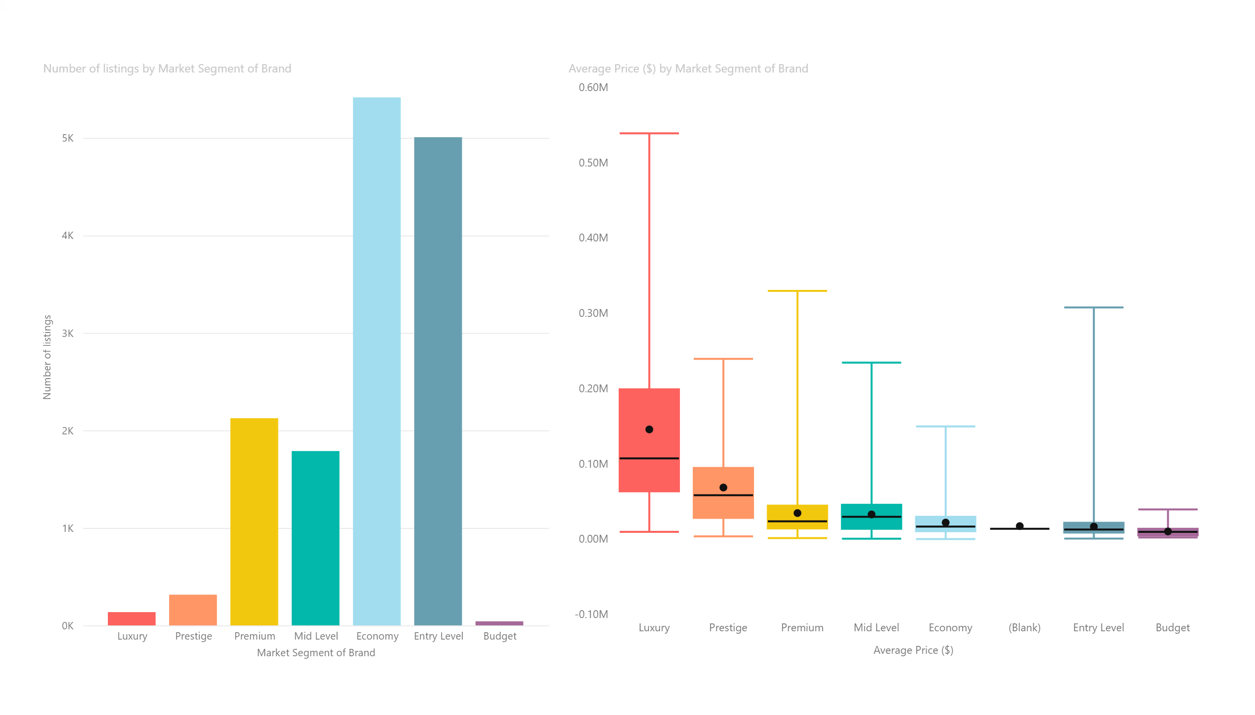
Brand Segment
Notes:
Number of listings by Market Segment of Brand
No alt text provided.
Average Price ($) by Market Segment of Brand
No alt text provided.

Slide 3
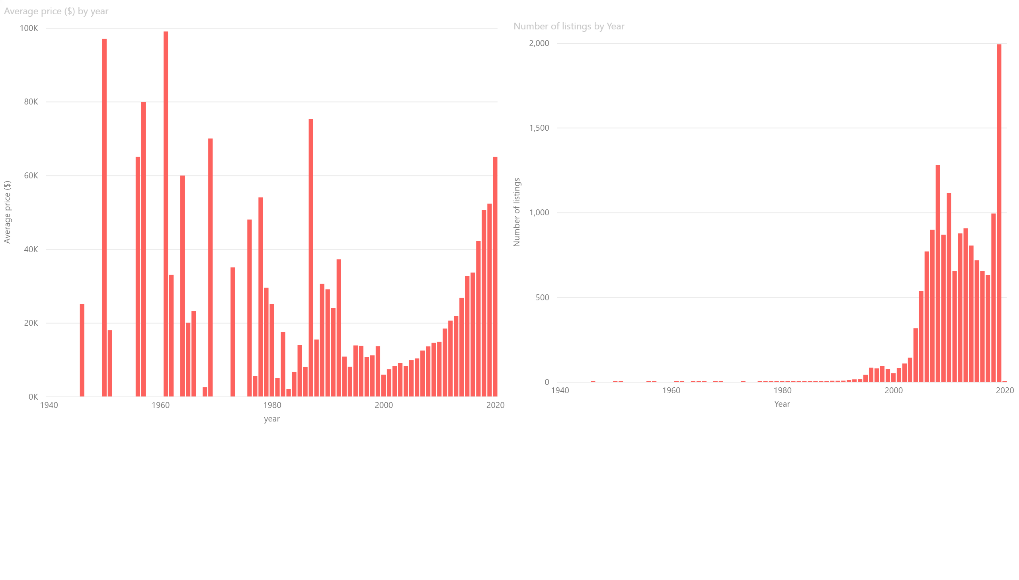
Year
Notes:
columnChart
No alt text provided.
columnChart
No alt text provided.

Slide 4
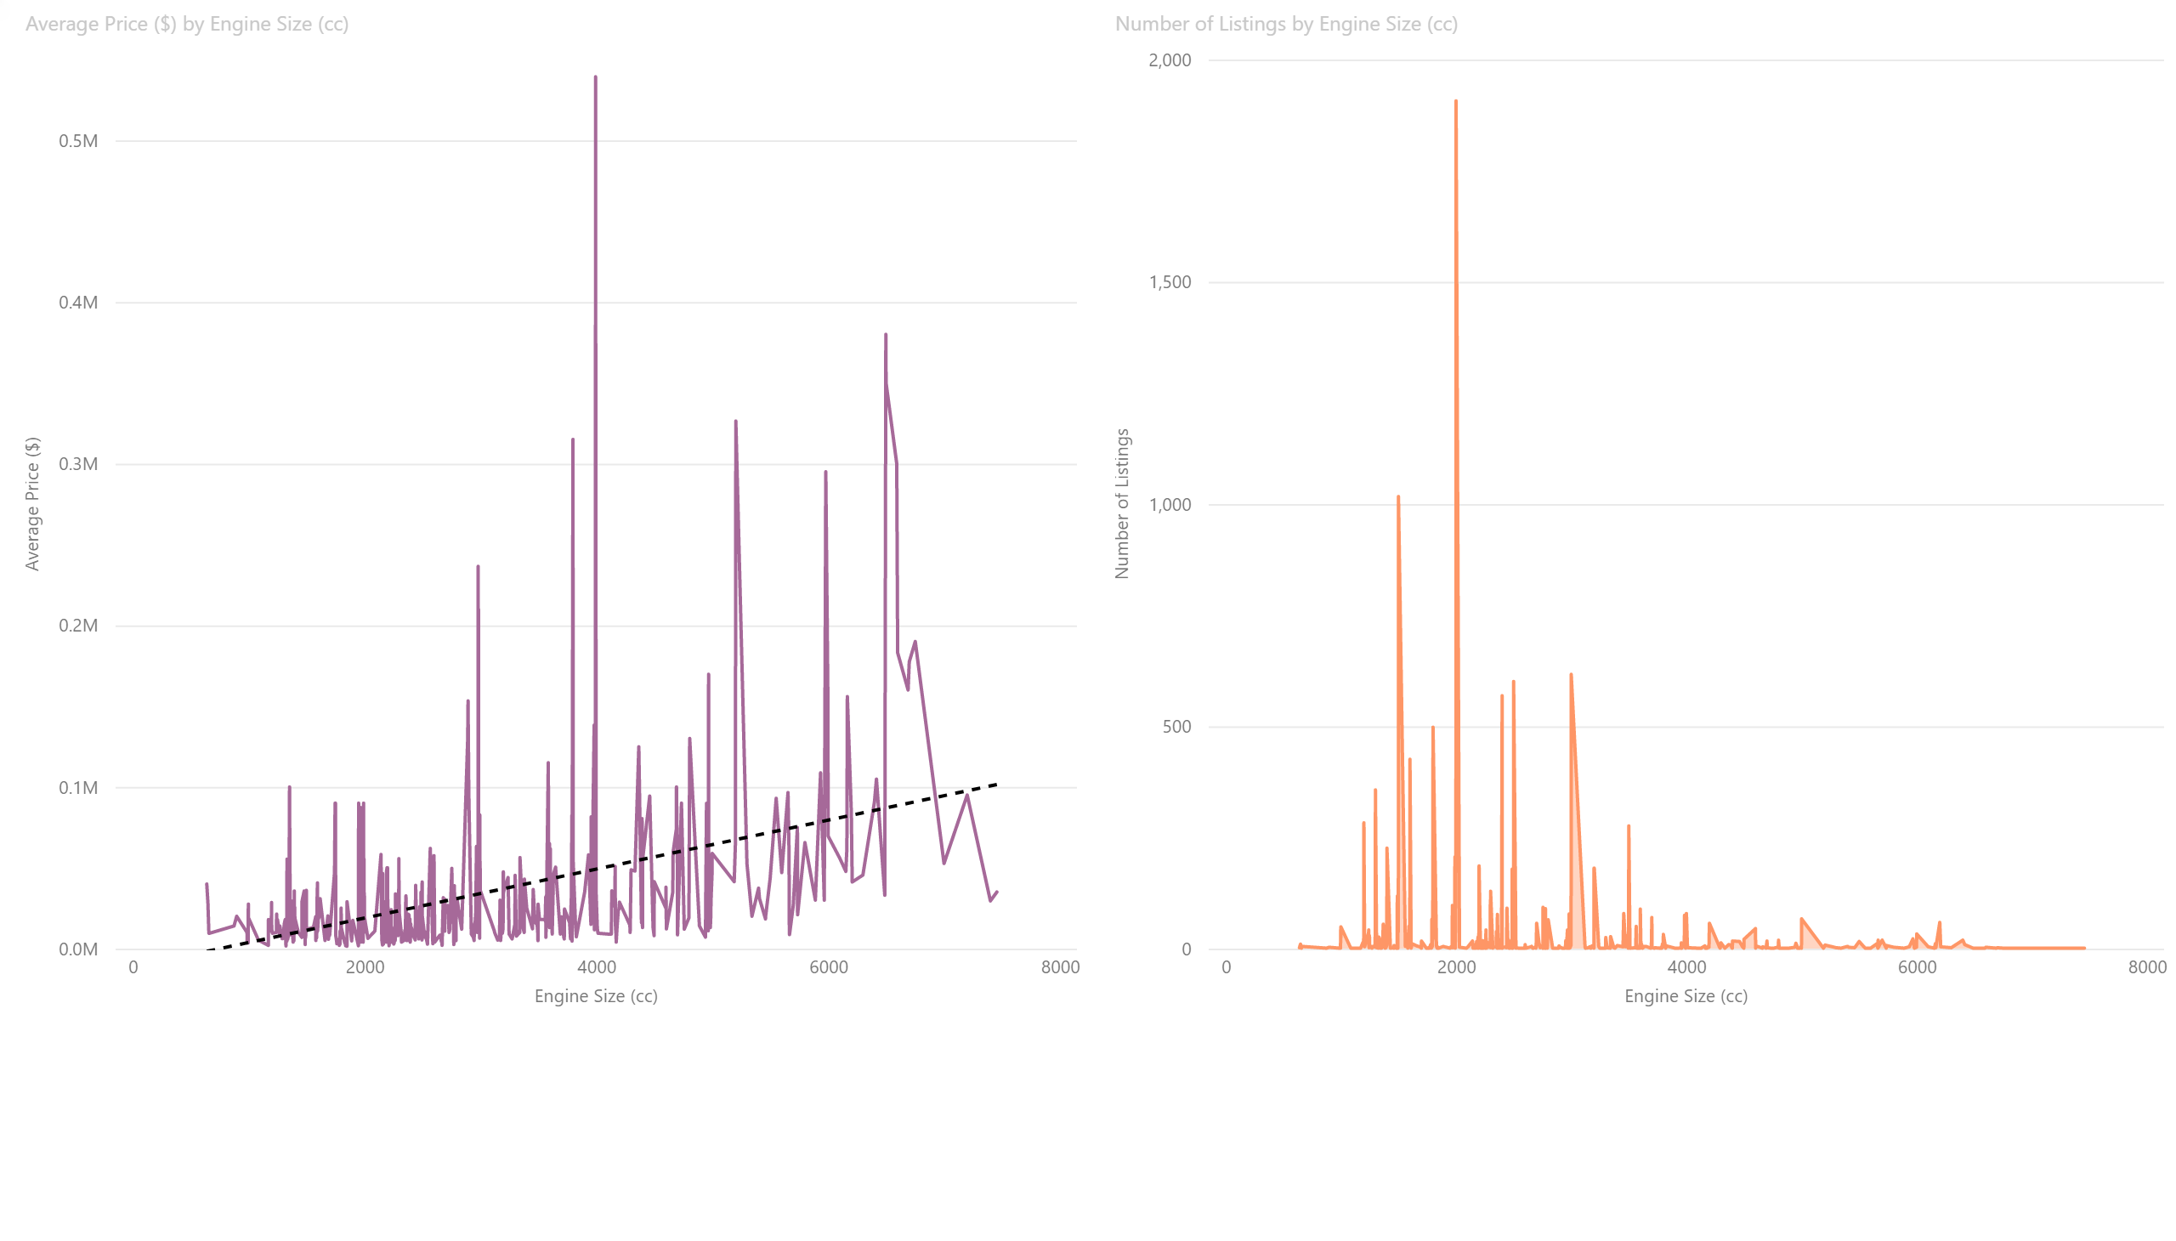
Engine Size
Notes:
lineChart
No alt text provided.
areaChart
No alt text provided.

Slide 5
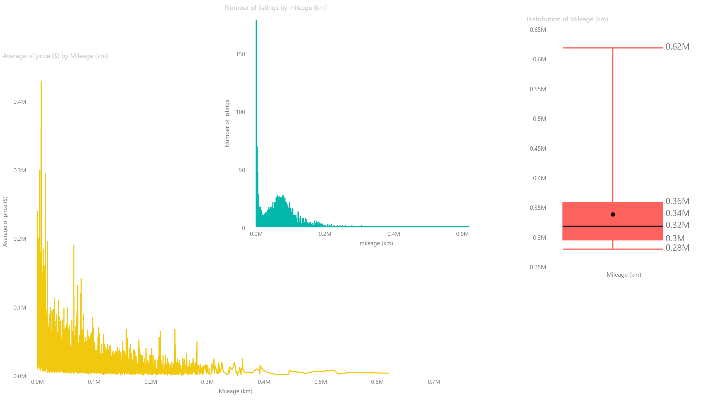
Mileage
Notes:
Distribution of Mileage (km)
No alt text provided.
lineChart
No alt text provided.
lineChart
No alt text provided.

Slide 6
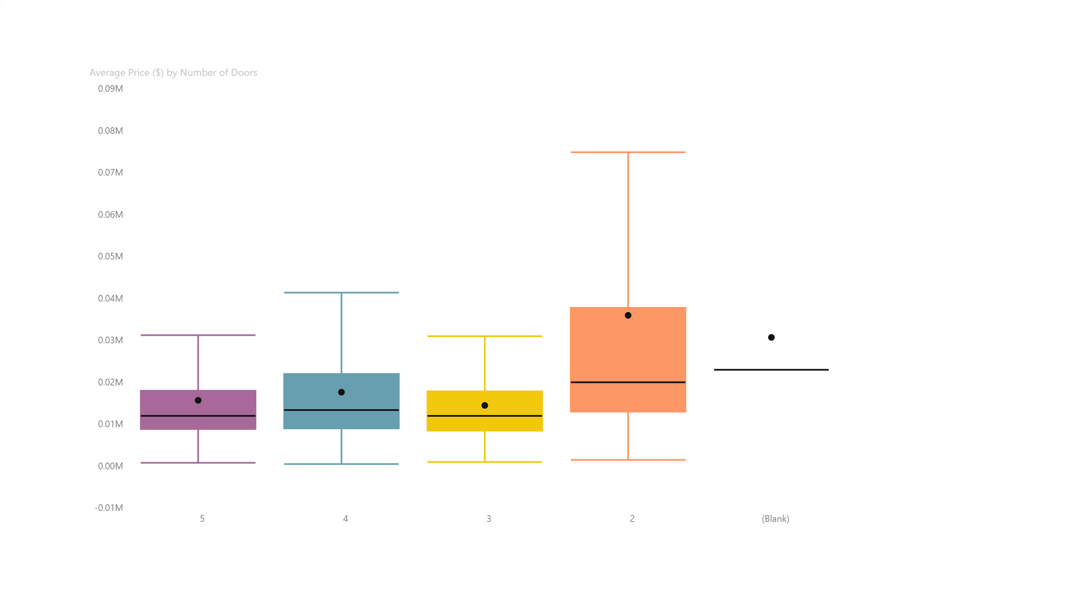
Door Average Price
Notes:
Average Price ($) by Number of Doors
No alt text provided.

Slide 7
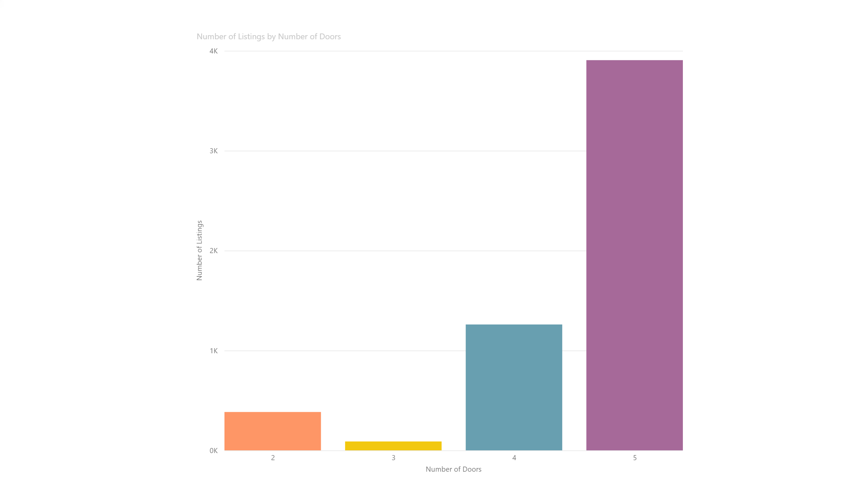
Door Instances
Notes:
columnChart
No alt text provided.

Slide 8
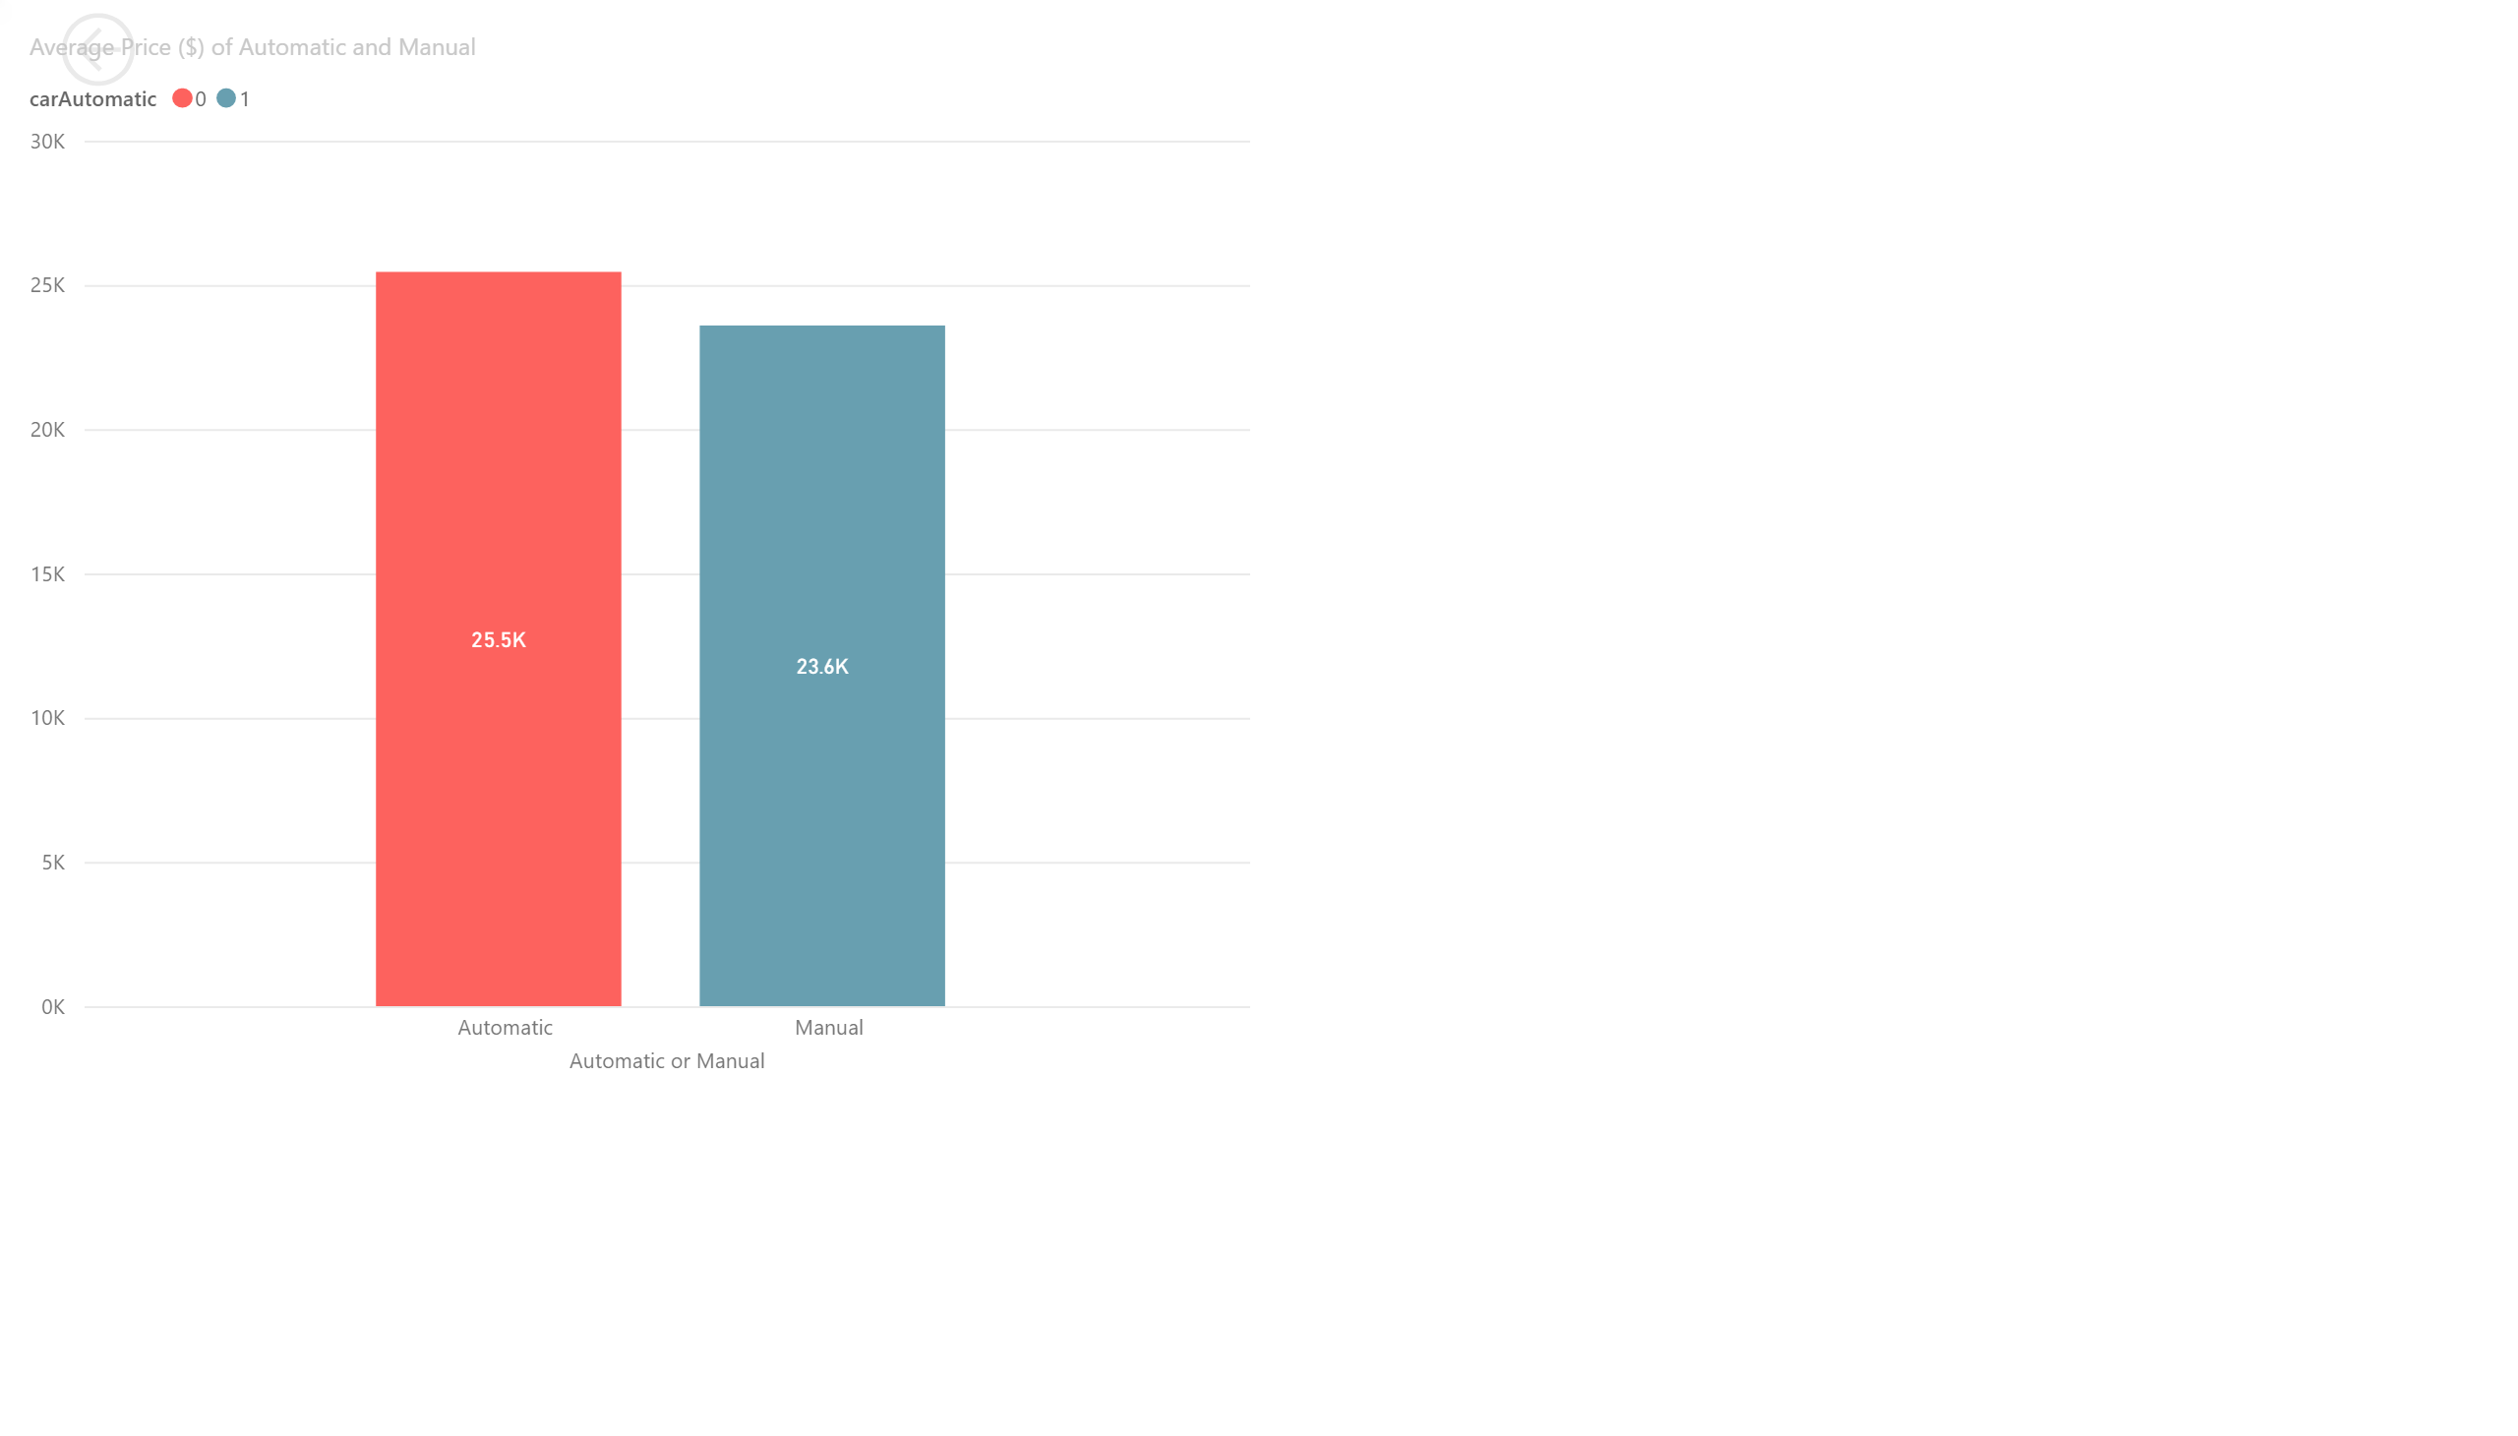
Transmission bar
Notes:
basicShape
No alt text provided.
Average Price ($) of Automatic and Manual
No alt text provided.

Slide 9
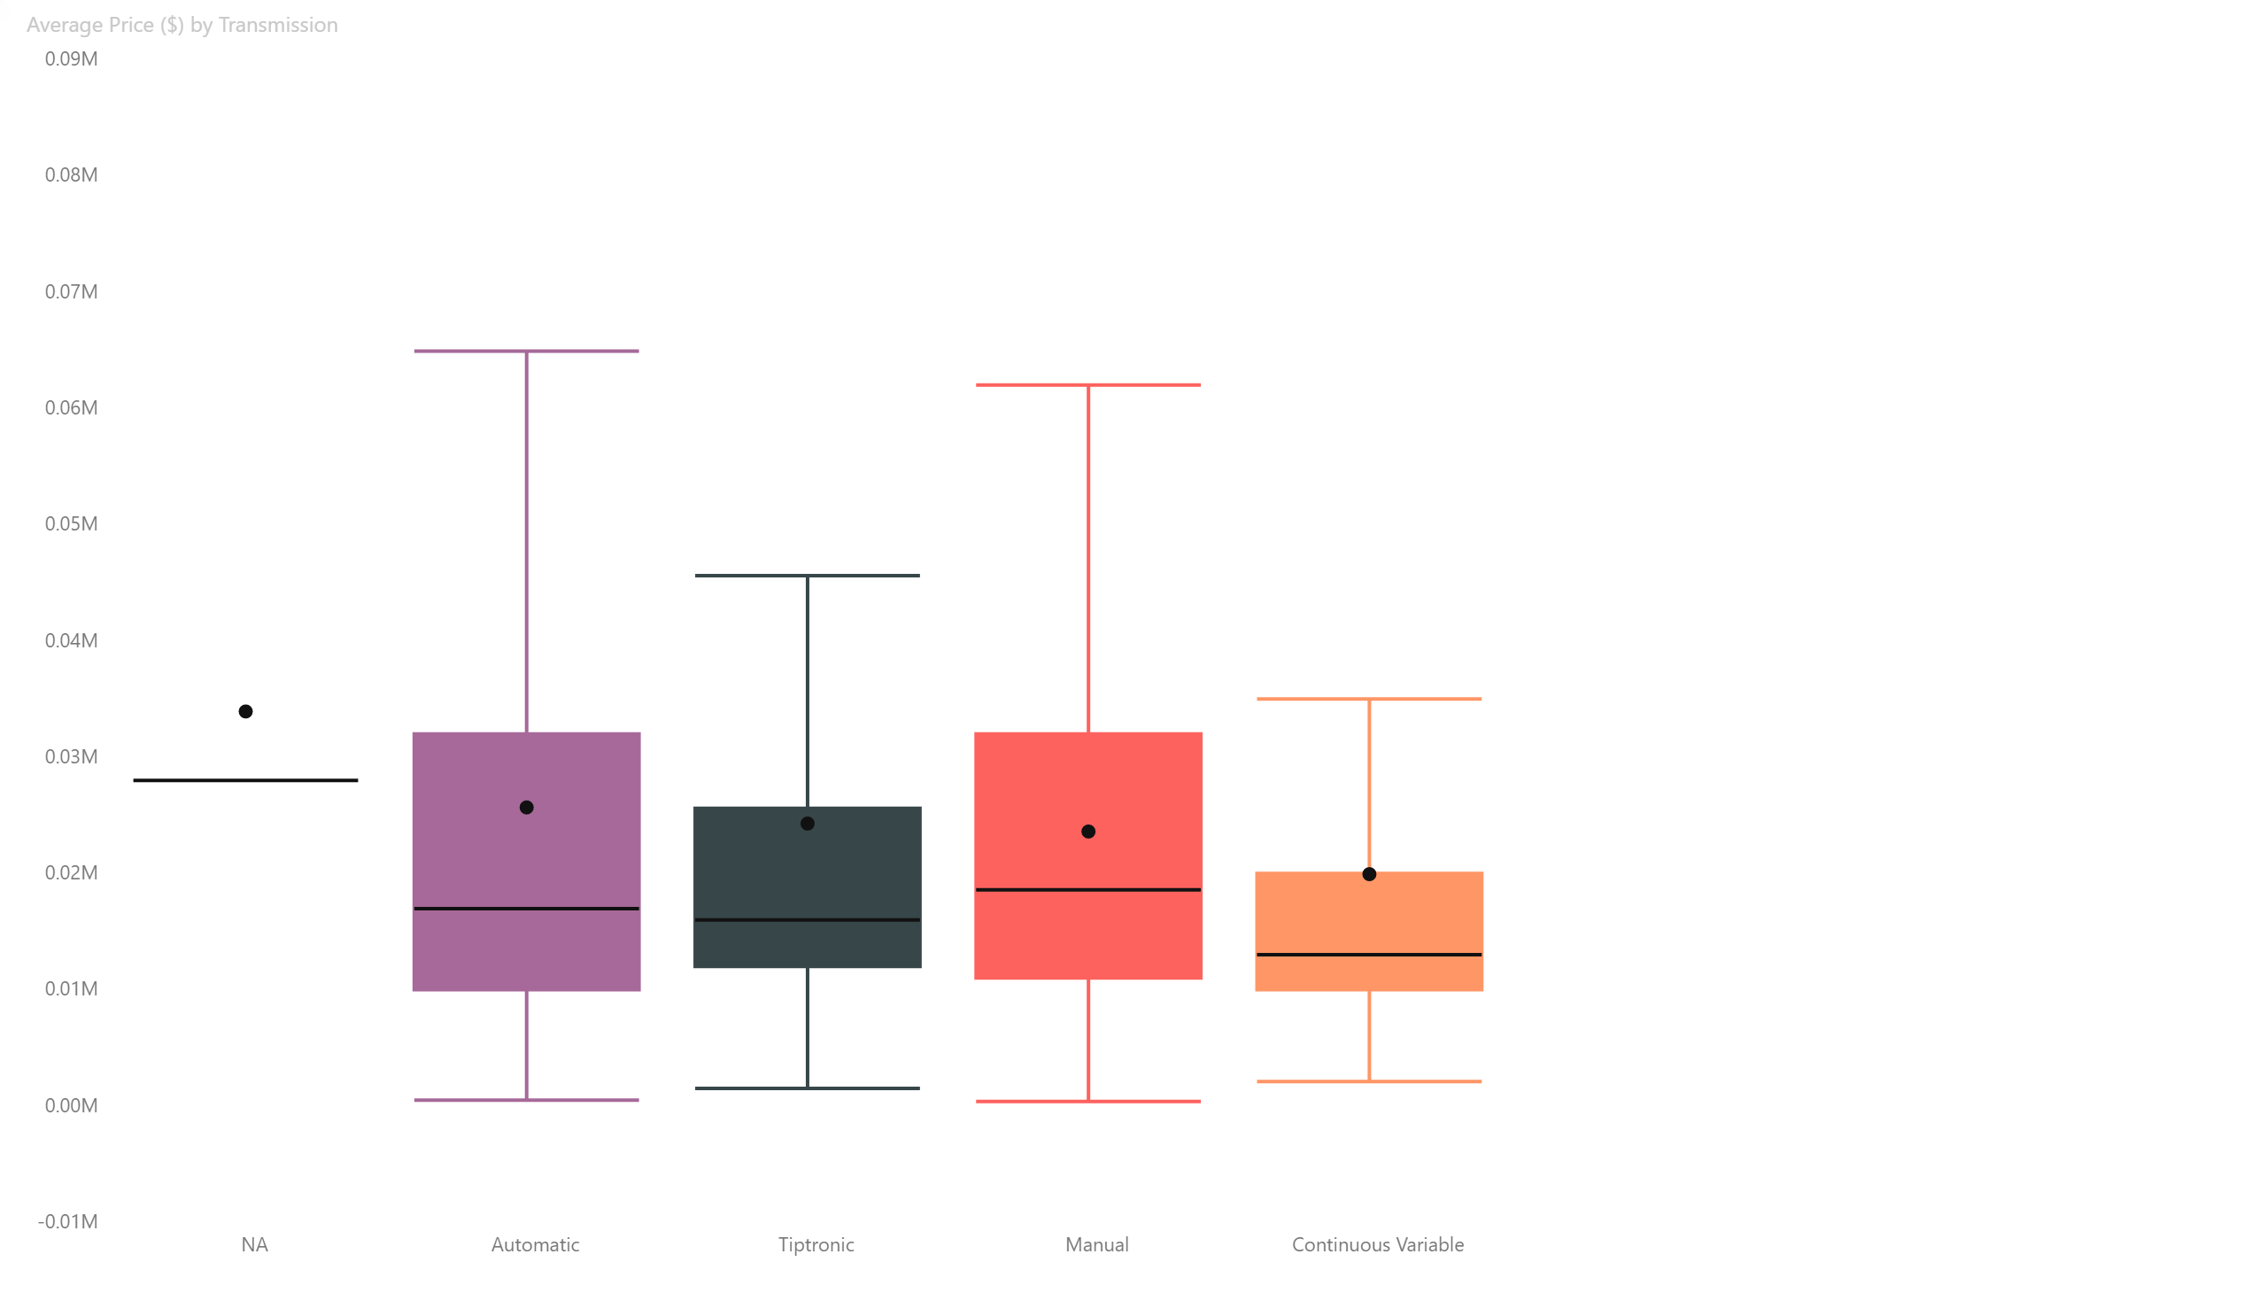
Transmission box plot
Notes:
Average Price ($) by Transmission
No alt text provided.

Slide 10
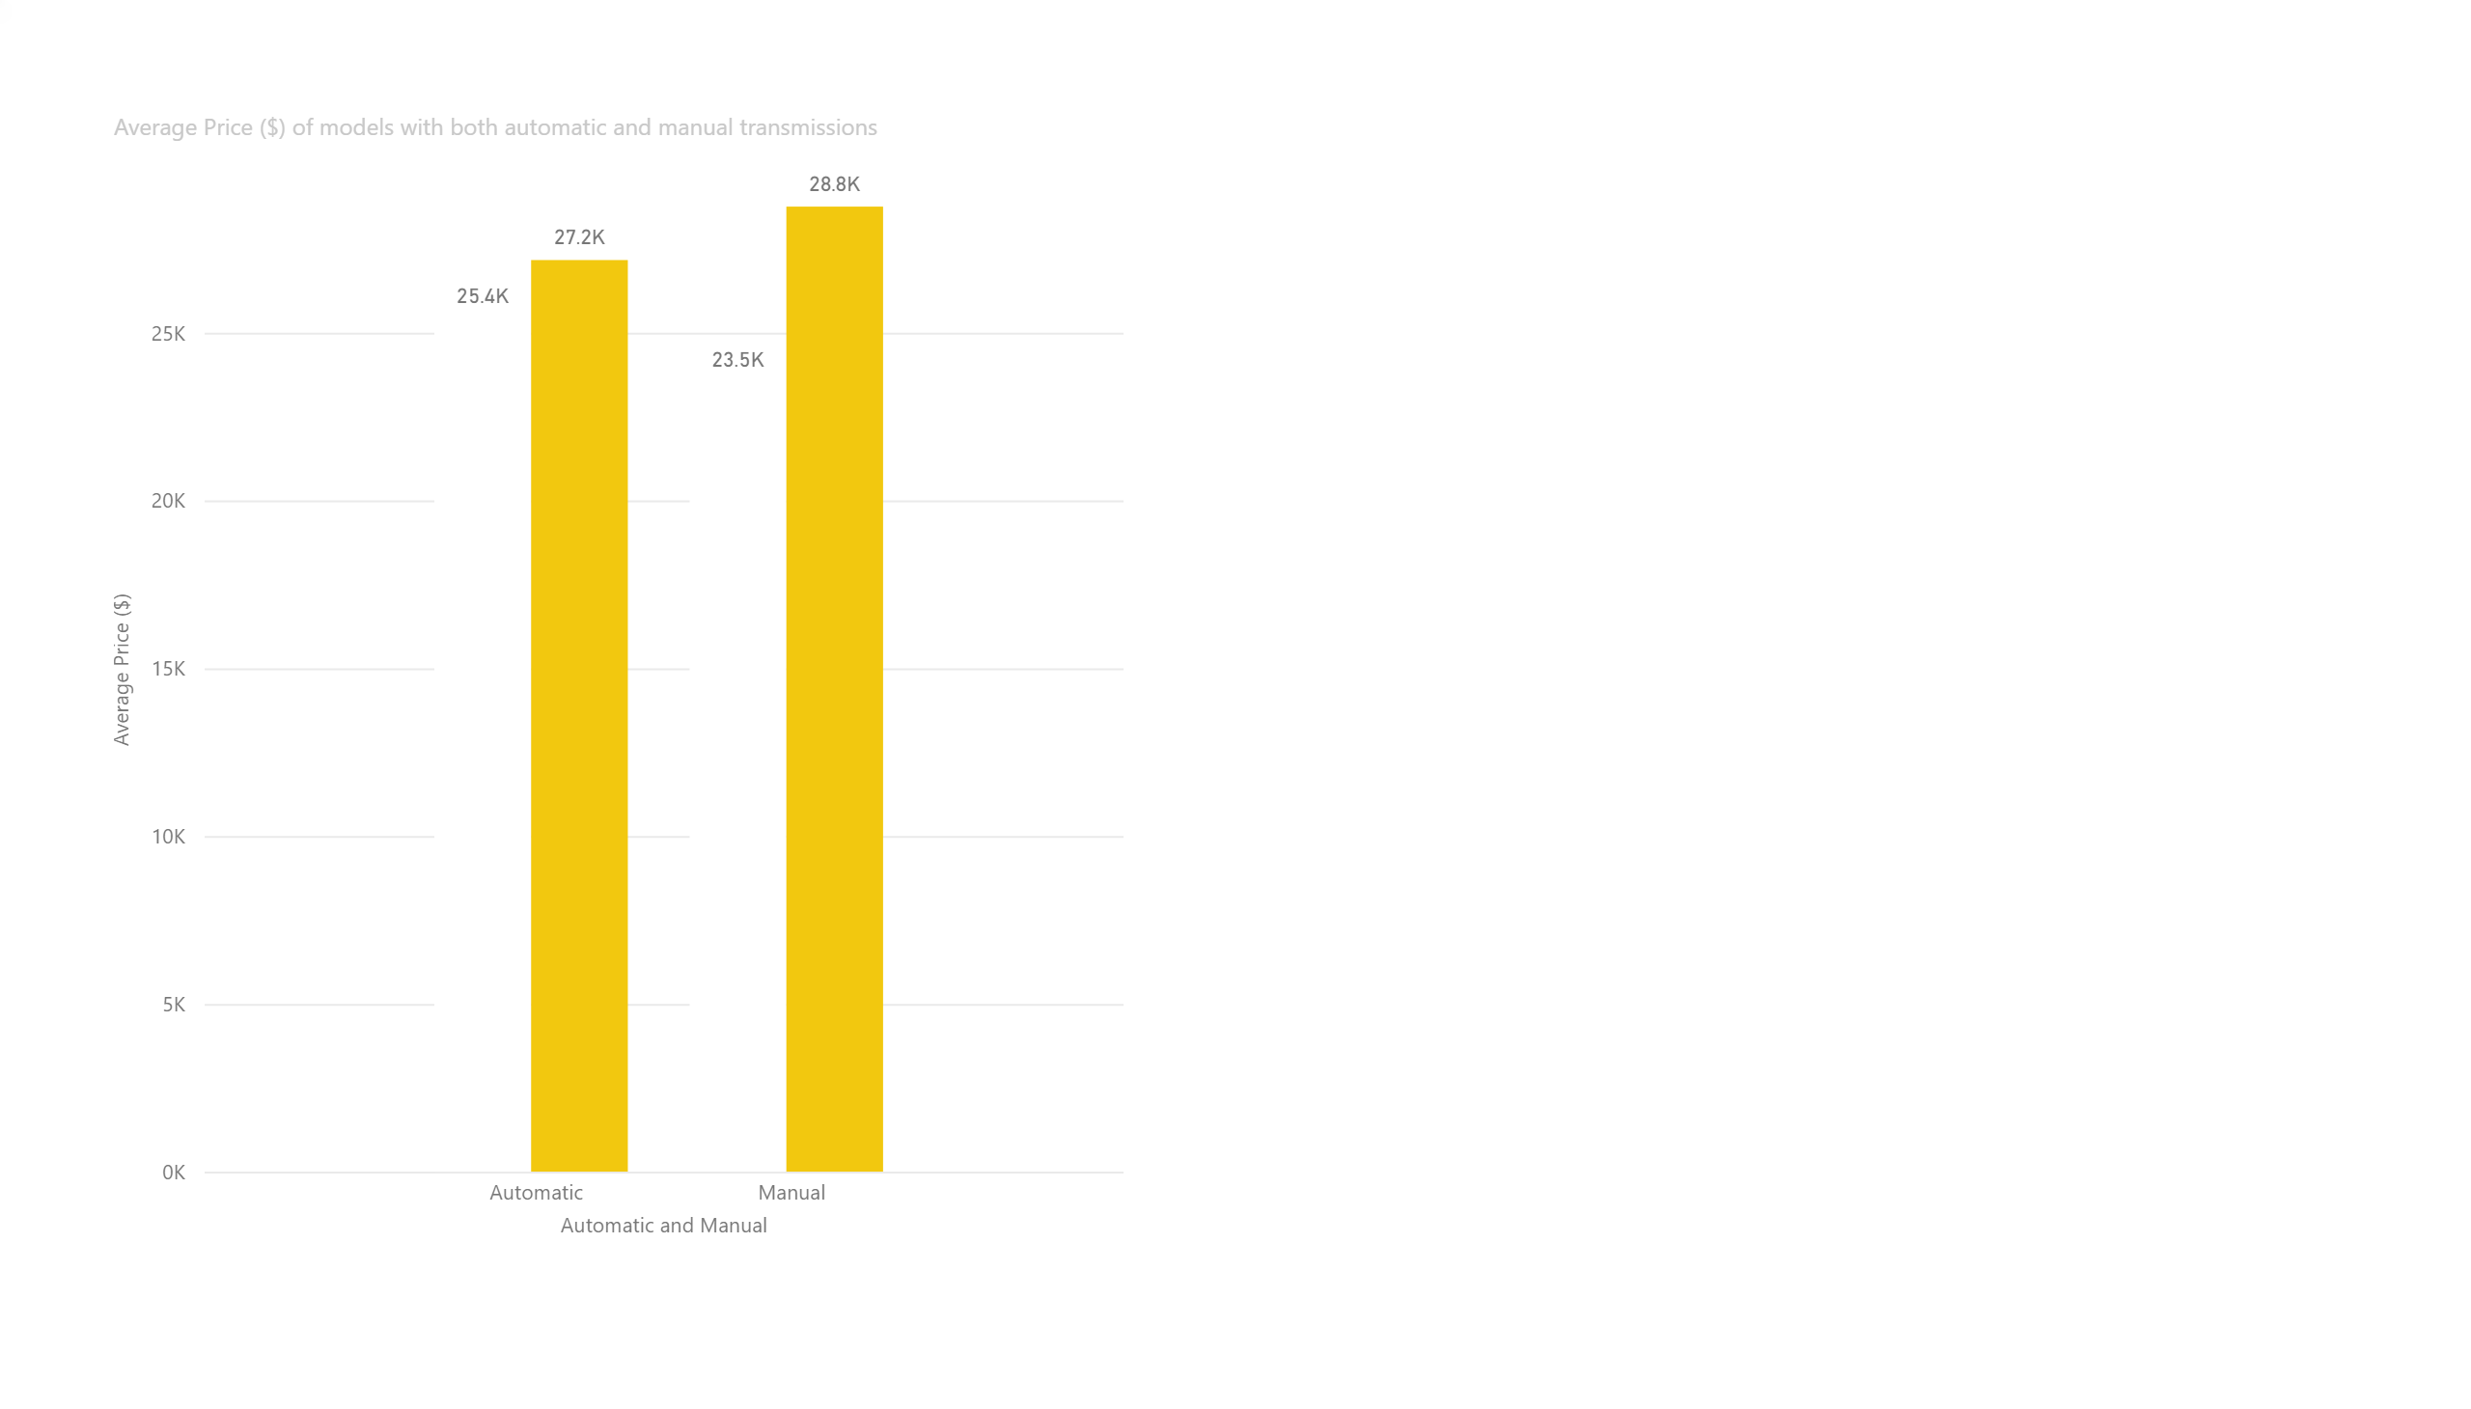
Models with both transmissions
Notes:
Average Price ($) of models with both automatic and manual transmissions
No alt text provided.

Slide 11
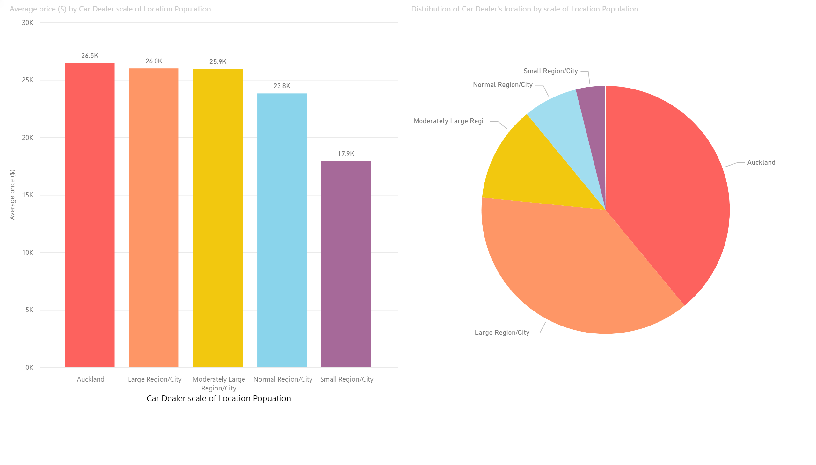
Location
Notes:
Average price ($) by Car Dealer scale of Location Population
No alt text provided.
Distribution of Car Dealer's location by scale of Location Population
No alt text provided.

Slide 12
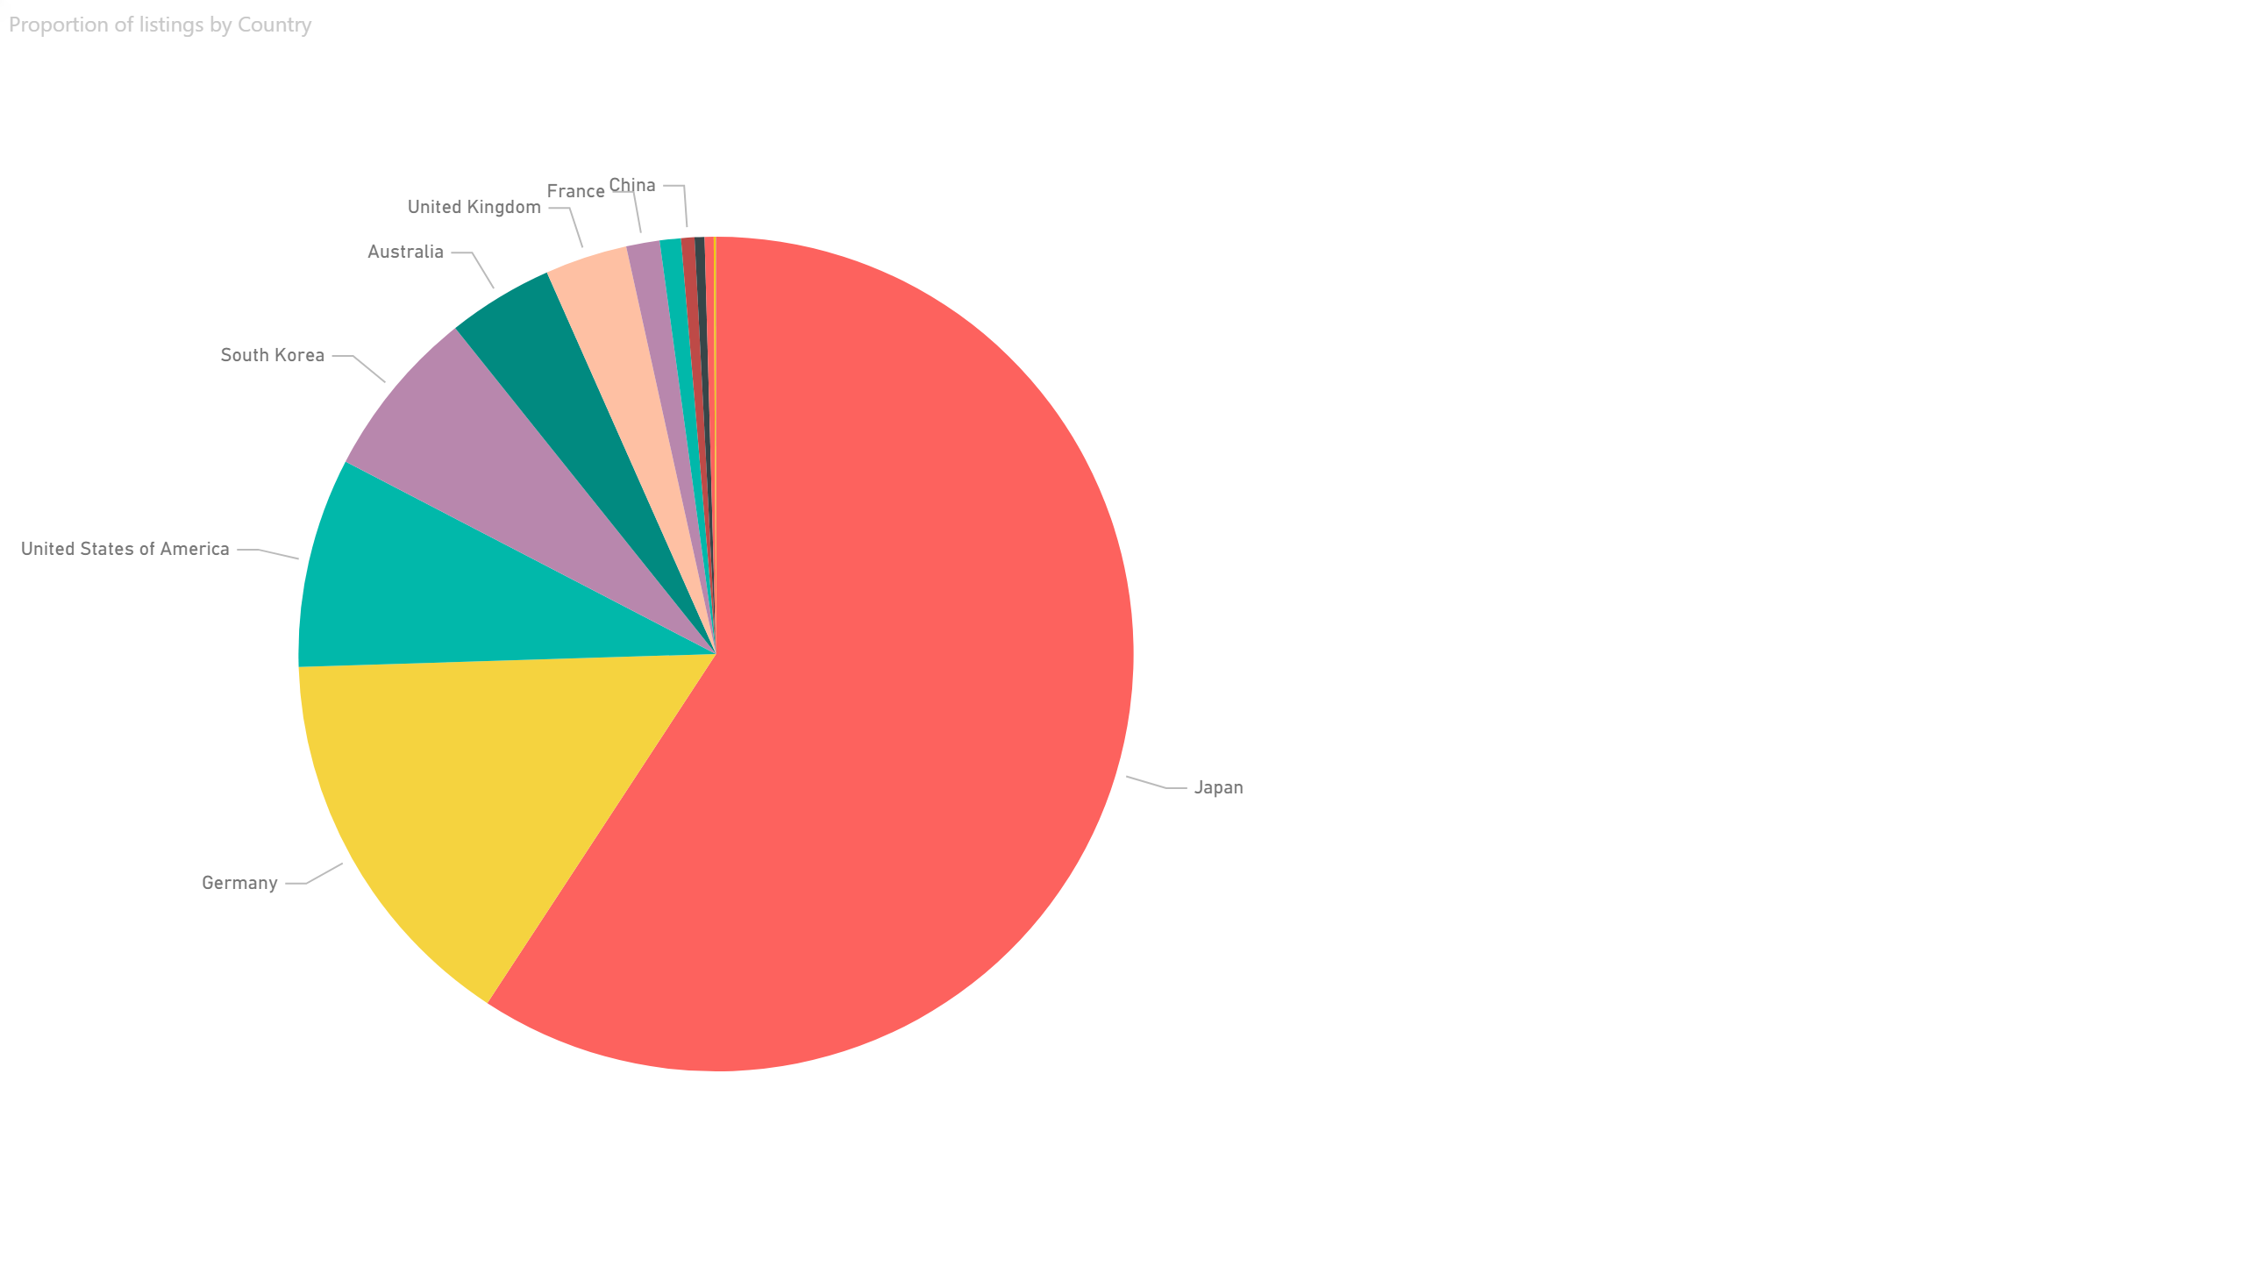
Proportion by Country
Notes:
Proportion of listings by Country
No alt text provided.

Slide 13
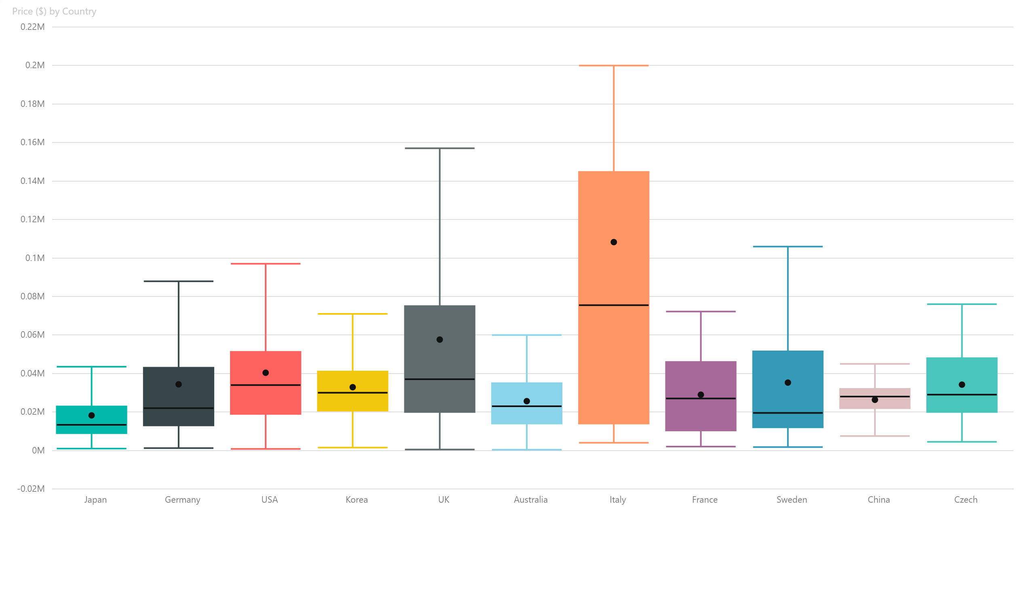
Price by Country
Notes:
Price ($) by Country
No alt text provided.

Slide 14
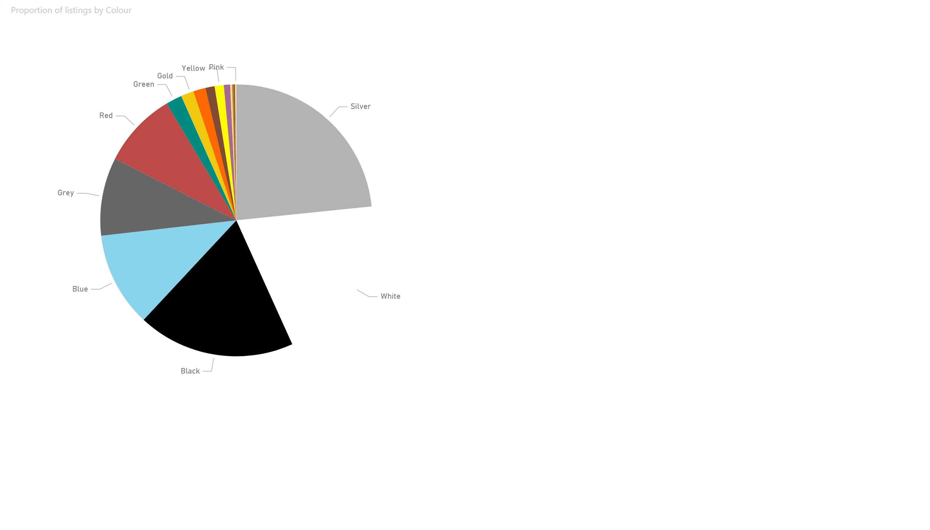
Proportion by Colour
Notes:
Proportion of listings by Colour
No alt text provided.

Slide 15
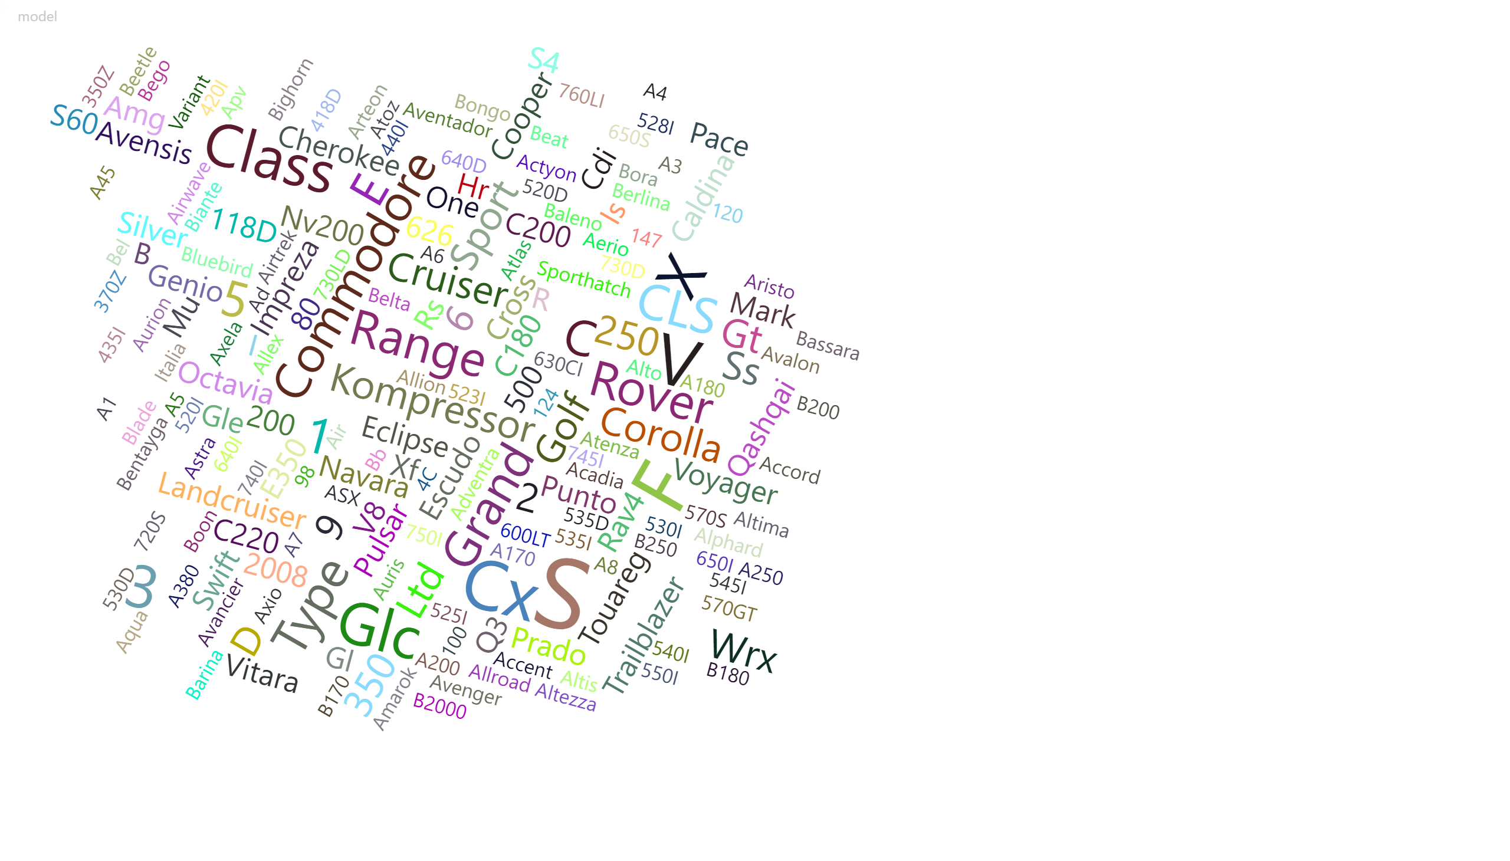
Models
Notes:
WordCloud1447959067750
No alt text provided.

